Slide 1
Modular Arithmetic
Several important cryptosystems make use of modular arithmetic. This is when the answer to a calculation is always in the range 0 – m where m is the modulus.
To calculate the value of n mod m, you take away as many multiples of m as possible until you are left with an answer between 0 and m.

Slide 2
Two numbers a and b are said to be “congruent modulo n” if
(a mod n) = (b mod n) → a ≡ b(mod n)
The difference between a and b will be a multiple of n
So a-b = kn for some value of k
E.g: 4 ≡9 ≡ 14≡19 ≡ -1 ≡ -6 mod 5
73 ≡ 4(mod 23); 21 ≡ -9(mod 10)
If a ≡ 0 (mod n), then n|a.

Slide 3
Properties of Congruences
a ≡ b (mod n) if n|(a-b)
a ≡ b (mod n) implies b ≡ a (mod n)
a ≡ b (mod n) and b ≡ c (mod n) imply a ≡ c (mod n)
Proof of 1.
If n|(a-b), then (a-b) = kn for some k. Thus, we can write
a = b + kn. Therefore,
(a mod n) = (remainder when b + kn is divided by n) = (remainder when b is divided by n) = (b mod n).

Slide 4
Examples
23 ≡ 8 (mod 5) because 23 -8 =15 = 5x3
-11 ≡ 5 (mod 8) because -11-5 =-16 = 8x(-2)
81 ≡ 0 (mod 27) because 81-0=81 = 27x3

Slide 5
Properties of Modular Arithmetic
[(a mod n) + (b mod n)] mod n = (a + b) mod n
[(a mod n) - (b mod n)] mod n = (a - b) mod n
[(a mod n) x (b mod n)] mod n = (a x b) mod n
Proof of 1.
Let (a mod n) = Ra and (b mod n) = Rb. Then, we can write
a = Ra + jn for some integer j and b = Rb + kn for some integer k.
(a + b) mod n = (Ra + jn + Rb + kn) mod n
= [Ra + Rb + (k + j) n] mod n
= (Ra + Rb) mod n
= [(a mod n) + (b mod n)] mod n

Slide 6
Examples
11 mod 8 = 3; 15 mod 8 = 7
[(11 mod 8 ) + (15 mod 8)] mod 8 = 10 mod 8 = 2
(11 + 15) mod 8 = 26 mod 8 = 2
[(11 mod 8 ) - (15 mod 8)] mod 8 = -4 mod 8 = 4
(11 - 15) mod 8 = -4 mod 8 = 4
[(11 mod 8 ) x (15 mod 8)] mod 8= 21 mod 8 = 5
(11 x 15) mod 8 = 165 mod 8 = 5

Slide 7
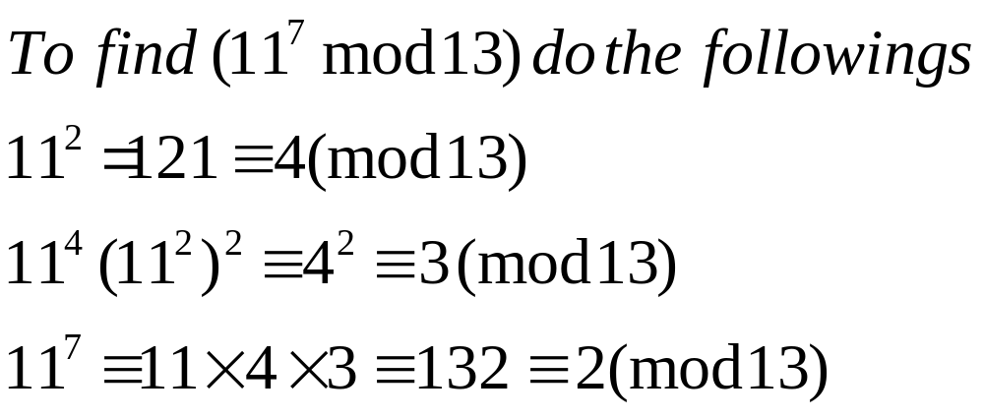
Exponentiation
Exponentiation is done by repeated multiplication, as in ordinary arithmetic.

Slide 8
A good thing about modular arithmetic is that the numbers you are working with will be kept relatively small. At each stage of an algorithm, the mod function should be applied.
Thus to multiply 39 * 15 mod 11 we first take mods to get
  39 mod 11 = 6 and 15 mod 11= 4
  The multiplication required is now
  6*4 mod 11 = 24 mod 11 = 2

Slide 9
Modular Division
What is 5 ÷ 3 mod 11?
We need to multiply 5 by the inverse of 3 mod 11
When you multiply a number by its inverse, the answer is 1.
Thus the inverse of 2 is ½ since 2* ½ = 1
The inverse of 3 mod 11 is 4 since 3*4=1 mod 11
Thus 5 ÷ 3 mod 11 = 5*4 mod 11 = 9 mod 11

Slide 10
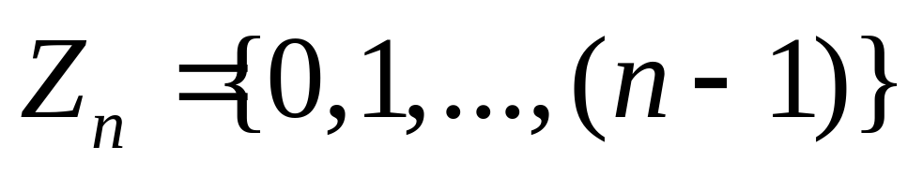
Properties of Modular Arithmetic
Define the set Z_{n} as the set of nonnegative integers less than n:
This set is referred to as the set of residues, or residue classes (mod n). That is, each integer in Zn represents a residue class.

Slide 11
Properties of Modular Arithmetic
We can label the residue classes (mod n) as:
[0],[1],[2],...,[n-1], where
[r] = {a: a is an integer, a ≡ r (mod n)}.
E.g.: The residue classes (mod 4) are
[0] = {..., -16,-12,-8,-4,0,4,8,12,16, ...}
[1] = {..., -15,-11,-7,-3,1,5,9,13,17, ...}
[2] = {..., -14,-10,-6,-2,2,6,10,14,18, ...}
[3] = {..., -13,-9,-5,-1,3,7,11,15,19, ...}

Slide 12
Properties of Modular Arithmetic
Property | Expression
Cummitative Laws | (w + x) mod n = (x + w) mod n (w x x) mod n = (x x w) mod n
Associative Laws | [(w + x) + y] mod n = [w + (x + y)] mod n [(w x x) x y] mod n = [w x (x x y)] mod n
Distributive Law | [w x (x + y)] mod n = [(w x x) + (w x y)] mod n
Identities | (0 + w) mod n = w mod n (1 x w) mod n = w mod n
Additive Inverse (-w) | For each w Z_{n}, there exists a z such that w + z ≡ 0 mod n

Slide 13
Prime Numbers
A prime number is divisible only by 1 and itself
For example: {2, 3, 5, 7, 11, 13, 17, …}
1 could also be considered prime, but it’s not very useful.

Slide 14
Prime Factorization
To factor a number n is to write it as a product of other numbers.
n = a * b * c
Or, 100 = 5 * 5 * 2 * 2
Prime factorization of a number n is writing it as a product of prime numbers.
143 = 11 * 13

Slide 15
Relatively Prime Numbers
Two numbers are relatively prime if they have no common divisors other than 1.
10 and 21 are relatively prime, in respect to each other, as 10 has factors of 1, 2, 5, 10 and 21 has factors of 1, 3, 7, 21.
The Greatest Common Divisor (GCD) of two relatively prime numbers can be determined by comparing their prime factorizations and selecting the least powers.

Slide 16
Relatively Prime Numbers Cont.
For example, 125 = 5³ and 200 = 2³ * 5²
GCD(125, 200) = 2⁰ * 5² = 25
If the two numbers are relatively prime the GCD will be 1.
Consider the following: 10(1, 2, 5, 10) and 21(1, 3, 7, 21)
GCD(10, 21) = 1
It then follows, that a prime number is also relatively prime to any other number other than itself and 1.

Slide 17

Fermat’s Little Theorem
If p is prime and a is an integer not divisible by p, then . . .
a^{p-1} 1 (mod p).
And for every integer a
a^{p} a (mod p).
This theorem is useful in public key (RSA) and primality testing.

Slide 18


Euler Totient Function: (n)
(n) = how many numbers there are between 1 and n-1 that are relatively prime to n.
(4) = 2 (1, 3 are relatively prime to 4)
(5) = 4 (1, 2, 3, 4 are relatively prime to 5)
(6) = 2 (1, 5 are relatively prime to 6)
(7) = 6 (1, 2, 3, 4, 5, 6 are relatively prime to 7)

Slide 19
Euler Totient Function Cont.
As you can see from (5) and (7), (n) will be n-1 whenever n is a prime number. This implies that (n) will be easy to calculate when n has exactly two different prime factors: (P * Q) = (P-1)*(Q-1), if P and Q are prime.

Slide 20
Euler’s Totient Theorem
This theorem generalizes Fermat’s theorem and is an important key to the RSA algorithm.
If GCD(a, p) = 1, and a < p, then a ^{(p)} 1(mod p).
In other words, If a and p are relatively prime, with a being the smaller integer, then when we multiply a with itself (p) times and divide the result by p, the remainder will be 1.

Slide 21
Euler’s Totient Theorem Cont.
Let’s test the theorem:
If a = 5 and p = 6
Then (6) = (2-1) * (3-1) = 2
So, 5 ⁽⁶⁾ = 25 and 25 = 24+1 = 6*4+1
=> 25 = 1(mod 6) OR 25 % 6 = 1
It also follows that a ^{(p)+1} a(mod p) so that p does not necessarily need to be relatively prime to a.

